Slide 1
Configuration Guide
(WAS – Jeus 6.0.0.5
for codelabor-spring-mvc-template)
2009. 07. 21
CODELABOR
Shin Sang Jae (codelabor@gmail.com)

Slide 2

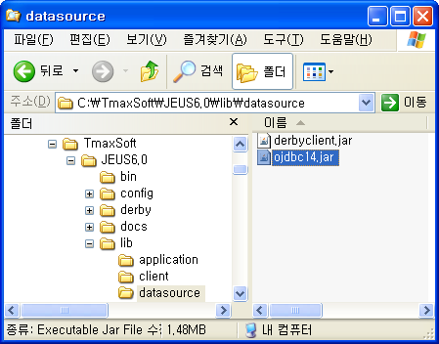
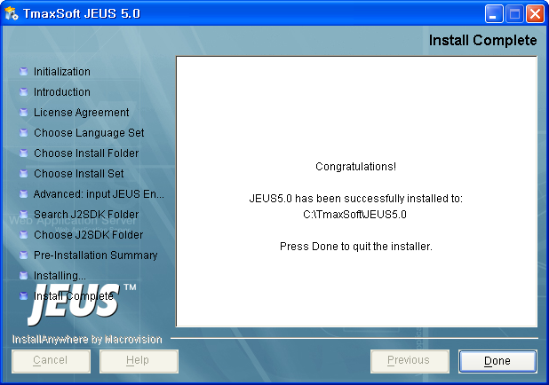
Jeus
Install JDBC Driver
Database: Oracle
JDBC Driver File: ojdbc14.jar
Install Directory: C:\TmaxSoft\JEUS6.0\lib\datasource

Slide 3
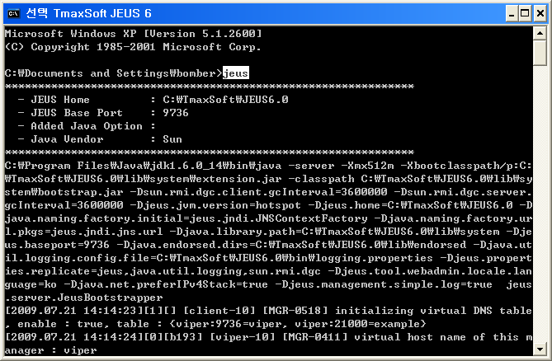
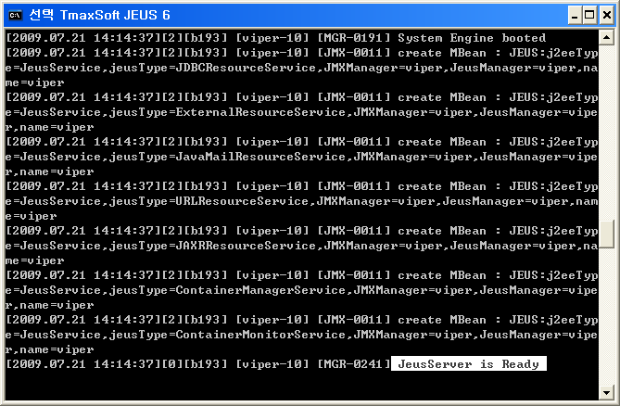
Jeus
Run Jeus Server
Run Jeus Server
Command: jeus

Slide 4
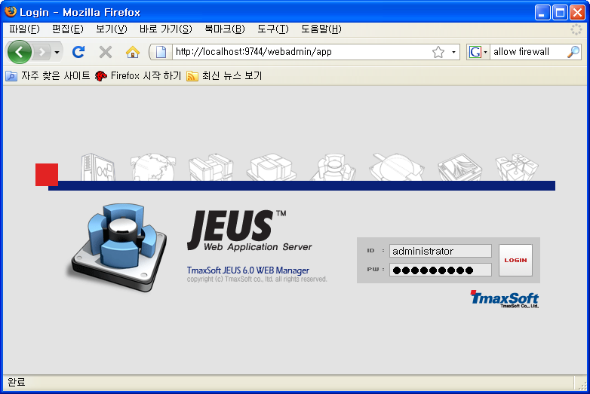
Jeus
Web Admin
Run Jeus WebAdmin
URL: http://localhost:9744/webadmin
ID: administrator
PW: jeusadmin

Slide 5
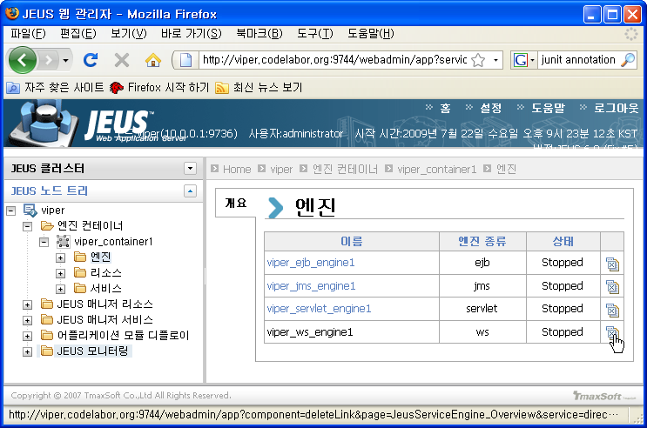
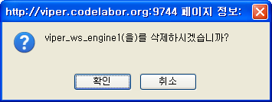
Jeus
Engine
Left Pan: Node Name > 엔진 컨테이너 > nodename_container1 > 엔진
Right Pan: nodename_ws_engine1
  Click Delete Icon

Slide 6
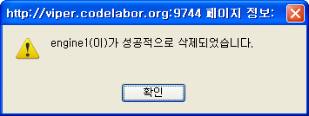
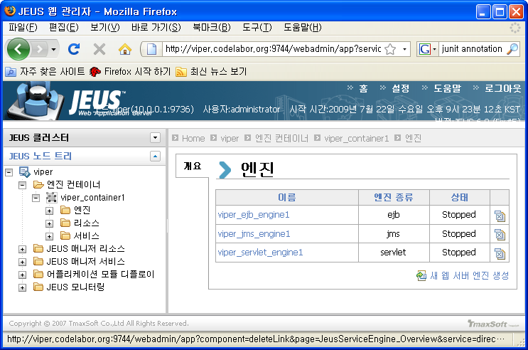
Jeus
Engine

Slide 7
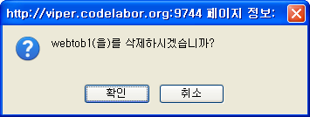
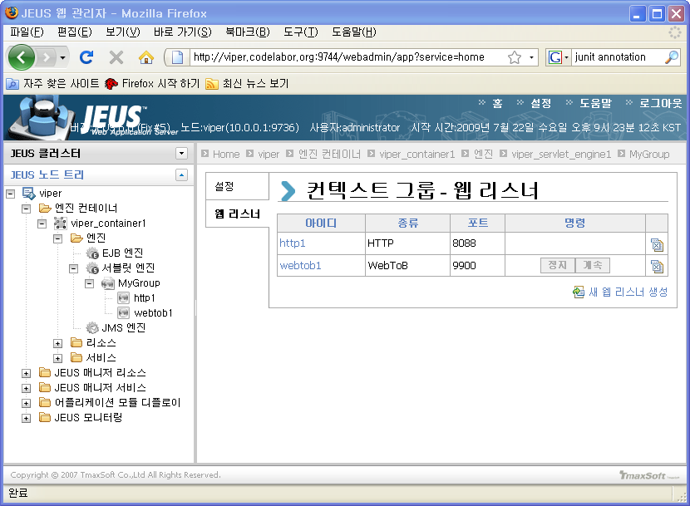
Jeus
Engine
Left Pan: Node Name > 엔진 컨테이너 > nodename_container1 > 엔진 > 서블릿엔진 > MyGroup
Right Pan: 웹 리스터 > webtob1
  Click Delete Icon

Slide 8
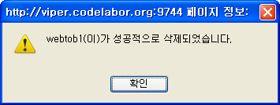
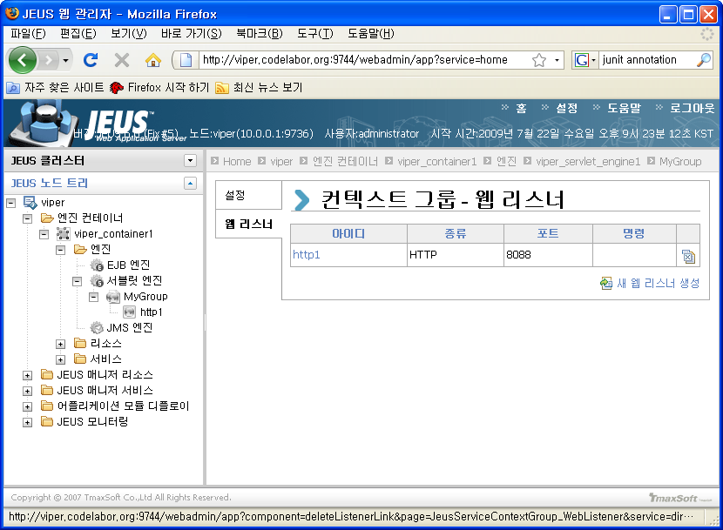
Jeus
Engine

Slide 9
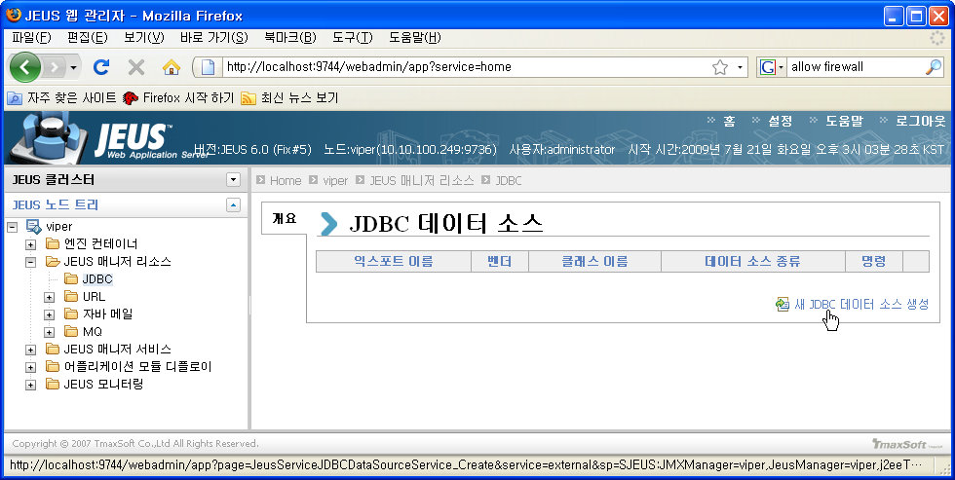
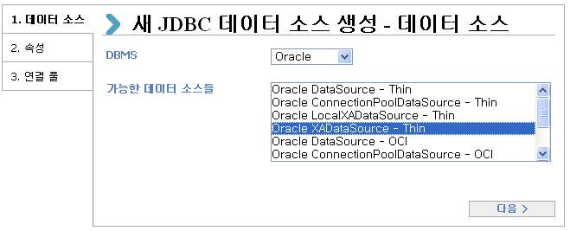
Jeus
JDBC DataSource
Left Pan: Node Name > JEUS 매니저 리소스 > JDBC
Right Pan: 새 JDBC 데이터 소스 생성
DBMS: Oracle
Data Source Type: Oracle XADataSource - Thin

Slide 10
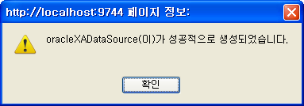
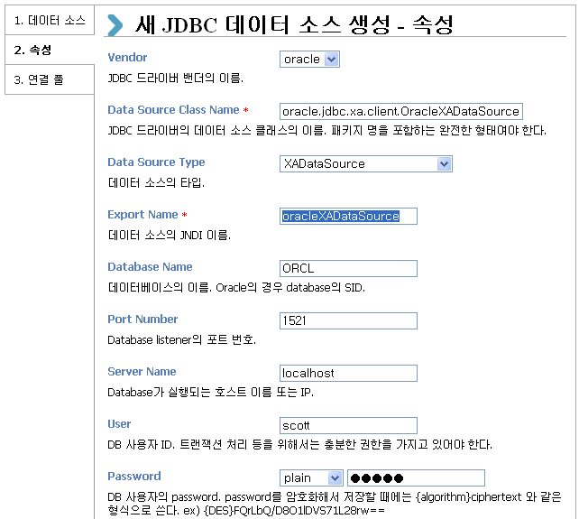
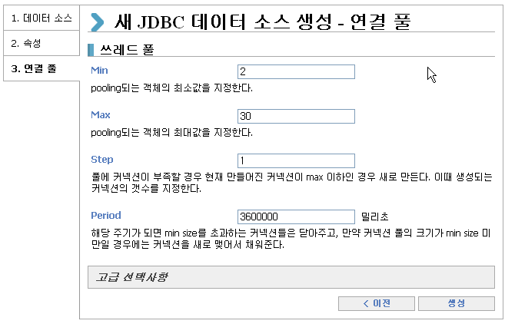
Jeus
JDBC DataSource
Export Name: oracleXADataSource
User: scott
Password: tiger

Slide 11
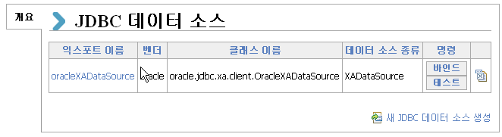
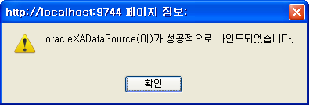
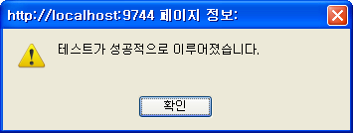
Jeus
Test DataSource
Bind / Test DataSource

Slide 12
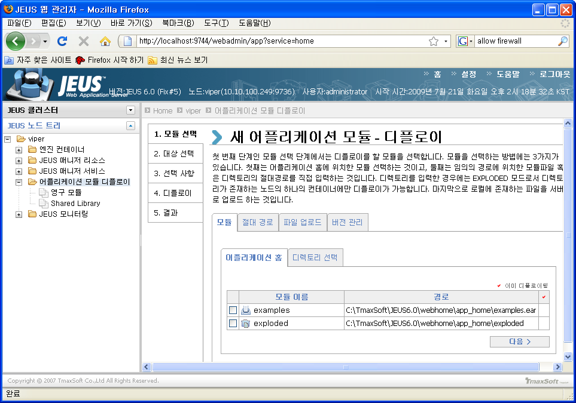
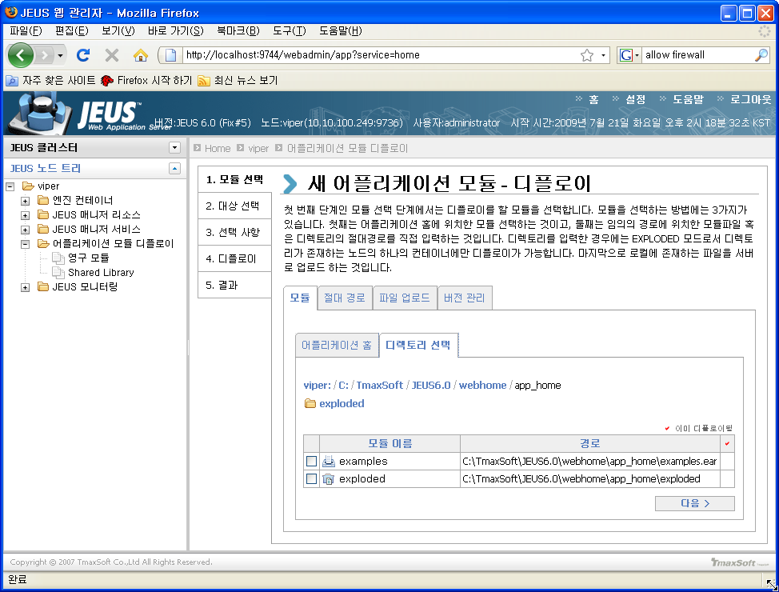
Jeus
Deploy Web Application
Left Pan: Node Name > 어플리케이션 모듈 디플로이
Right Pan: 모듈 선택 > 모듈 > 디렉토리 선택

Slide 13
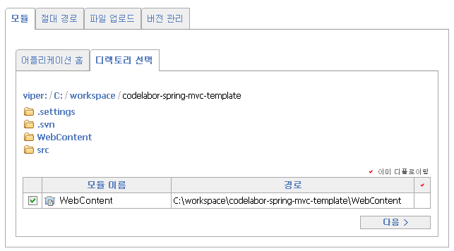
Jeus
Deploy Web Application
Change Directory
Directory: C:\workspace\codelabor-spring-mvc-template
Check WebContent
Next

Slide 14
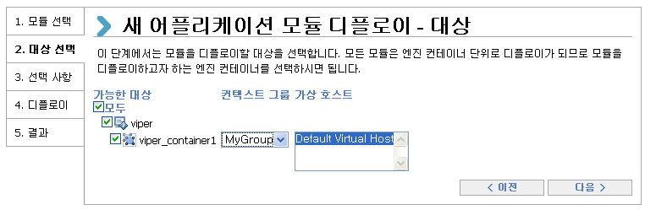
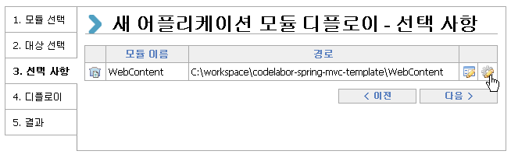
Jeus
Deploy Web Application
Select Target
Click Option (Toothed Wheel Button)

Slide 15
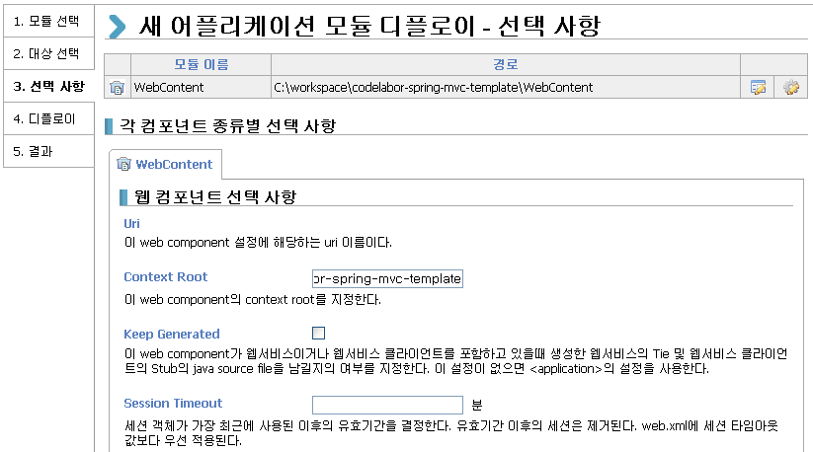
Jeus
Deploy Web Application
Set Context Root Name
Context Root: codelabor-spring-mvc-template

Slide 16
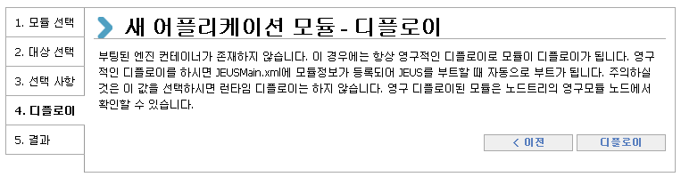
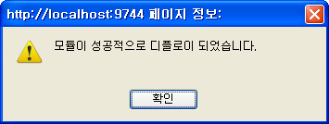
Jeus
Deploy Web Application
Deploy

Slide 17
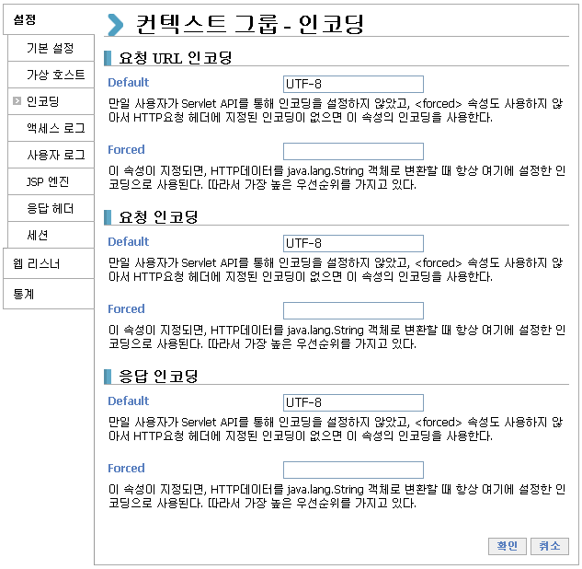
Jeus
Encoding
nodename > 엔진 컨테이너 > nodename_container1 > 엔진 > 서블릿 엔진 > MyGroup
컨텍스트 그룹 – 인코딩
  Request URL
    Default: UTF-8
  Request
    Default: UTF-8
  Response
    Default: UTF-8

Slide 18
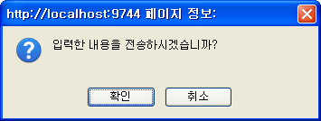
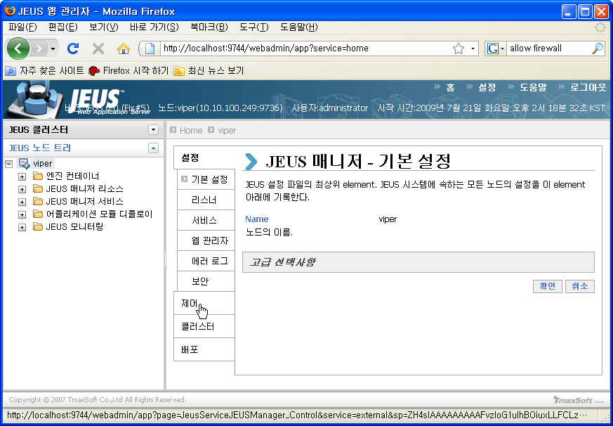
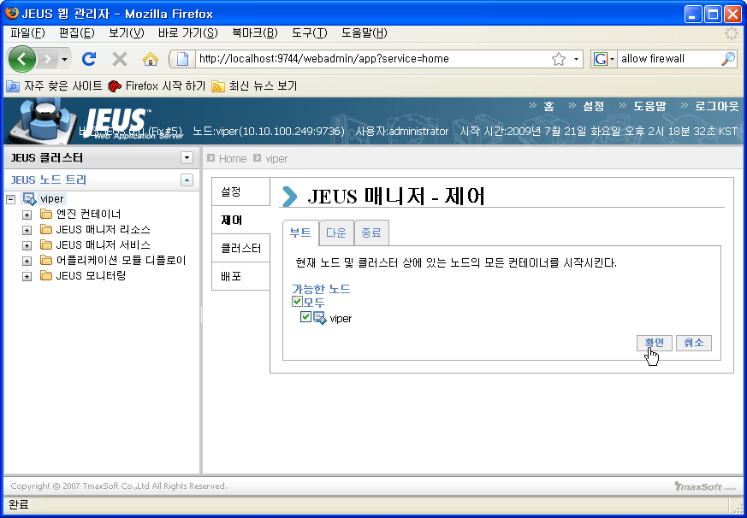
Jeus
Boot Node
Left Pan: Selet Node Name
Right Pan: Select 제어
부트 Tab: Check Node Name
Confirm

Slide 19
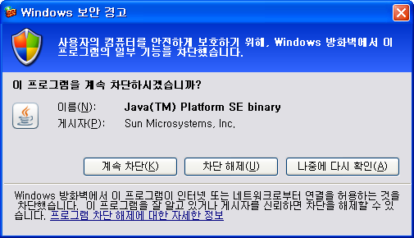
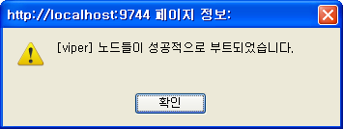
Jeus
Boot Node
Allow Firewall

Slide 20
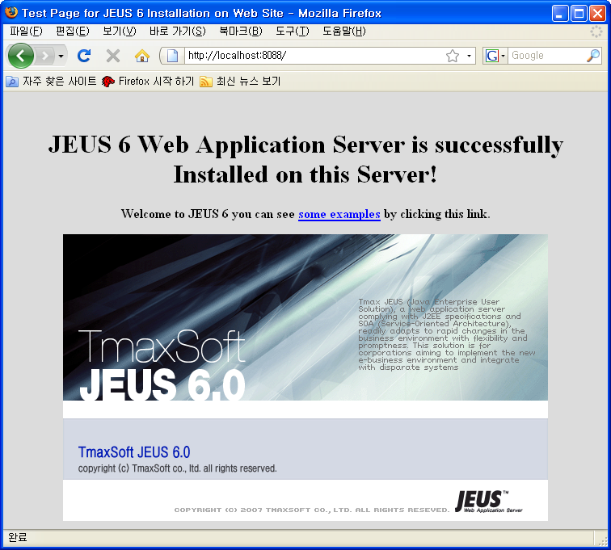
Jeus
Web Application
Browse Default Application
URL: http://localhost:8088/

Slide 21
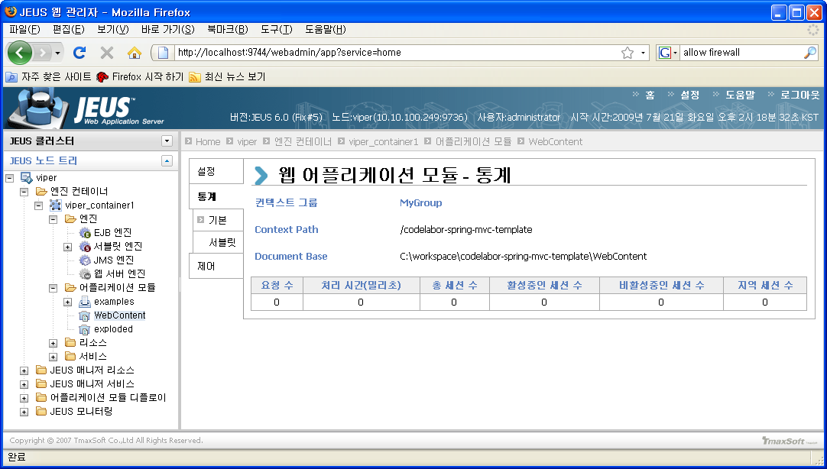
Jeus
Web Application
Browse Deployed Web Application
Node Name > 엔진 컨테이너 > nodename_container1 > 어플리케이션 모듈

Slide 22
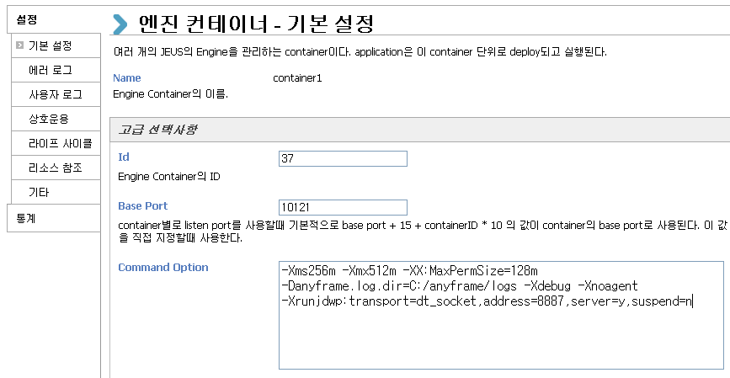
Jeus
Command Option
Left Pan: nodename > 엔진 컨테이너 > nodename_containername
Right Pan: 설정 > 기본 설정 > 고급 선택사항
Add Command Option:
  Log Directory: -Danyframe.log.dir=C:/anyframe/logs
  Remote Debugging: -Xdebug -Xnoagent -Xrunjdwp:transport=dt_socket,address=8887,server=y,suspend=n

Slide 23
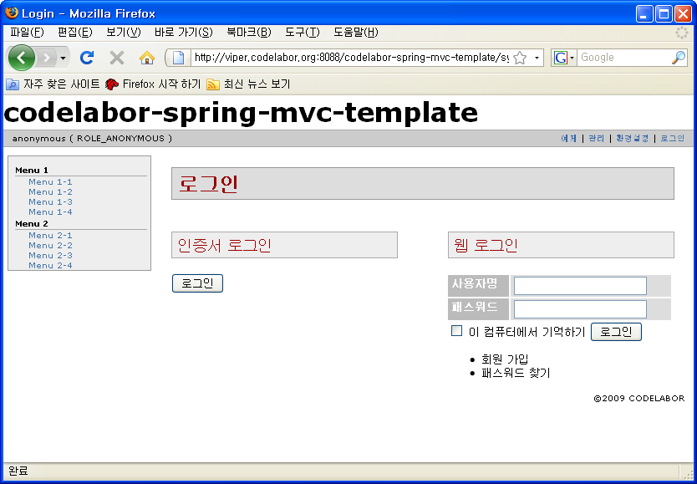
Jeus
Web Application
Browse Web Application
URL: http://localhost:8088/codelabor-spring-mvc-template

